Slide 1
COVID-19 and Fraud
A view of the Impact of COVID-19 on Organisational Fraud Risk

Slide 2
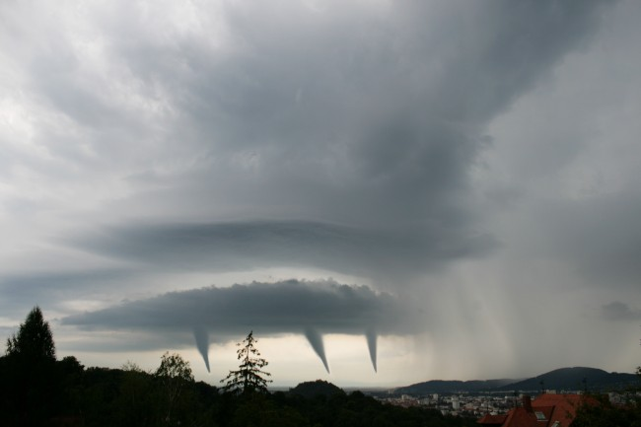
COVID-19 – The Perfect Storm
COVID-19 and the rapid and enforced implementation of Work from Home Measures, have left many organisations scrambling to adjust their ways of work and internal controls to respond accordingly. While absolutely necessary to mitigate the potential human tragedy associated with the pandemic, the question remains as to whether this has left our organisations vulnerable and exposed to an increased risk of fraud

Slide 3
The Drivers behind the Increase Risk

Slide 4


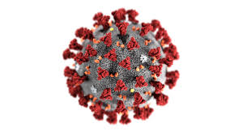


Back to Basics – The Always relevant Fraud Triangle
We revert to the Fraud Triangle, the key to understanding the impact of COVID-19 on Fraud Risk, in terms of why we are exposed to increased fraud risk
Rationalisation
*Donald Cressey – The Cressey Hypothesis 1953
Opportunity
Motivation

Slide 5







Rationalisation: People are our Strongest and Weakest links
Survival Ethics
Drop in Employee Morale
Job Losses
Rationalisation
Reduced Employee Rewards
Concern over Sustainability
Lack of Employer Empathy

Slide 6



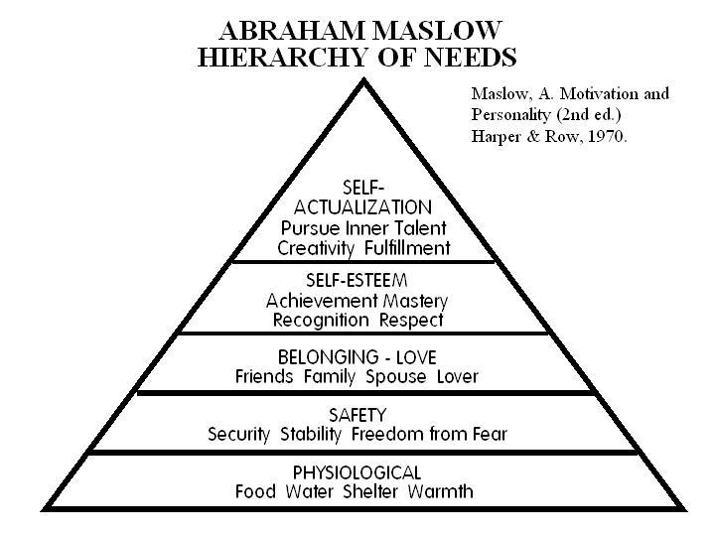



Motivation: Its Personal
Increase in Short Term Debt
Long term loan demands & defaults
Cash and Financial Needs
Motivation
Health Needs and
Medical Expenses
Need to cater for Housing
Increased family needs and protection

Slide 7





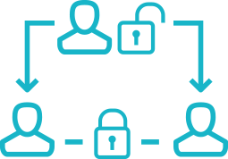



Opportunity: Never Miss a Good Crisis
Work from Home Practices
Rapid Digitisation of Processes
Need for Control Overrides
Opportunity
Ineffective Fraud Detection Systems
Reduced Segregation of Duties
Reduced Governance, “Emergency Processes” and Shift in Resources
Information Security and Cloud Security
Reduced Transparency

Slide 8
Key Potential Fraud Risks

Slide 9

So what’s Potentially Coming?
Increased Cybercrime
Increased Malware
WFH IS Security Risks
Lack of Patching and Security
Increased text and email phishing schemes
Opening of Secure Networks
Important to note that all relevant areas within your organisations will experience a heightened state of increased exposure inherent risk of fraud
Physical Security Risks
Deactivation of Biometrics and reactivation of “Legacy” access systems
Reduced office foot traffic increases the risk of theft of high value office assets
Reduced oversight at remote sensitive locations and warehouses (High Risk Items)
Increased emphasis needed on clean desk policies and ensuring that confidential documents are not accessible
Time and Productivity Risks
Decreased direct supervision
Time theft and overtime verification
General Deliverable Tracking
Bribery and Facilitation Payments
Increased bribery risk in Sales to win or retain business
Increased corruption risk in procurement
Increase facilitation / Corruption in Government Transactions

Slide 10
So what’s Potentially Coming?
Emergency Procurement and Governance Decisions
Potential for abuse of emergency processes to push through irregular spend or conflicted decisions
Reduced transparency and increased delegation limits may further increased exposure
Rapid Digitalisation of Processes
Critical organisational processes may be rapidly digitised
Potential impact on traditional fraud risk areas such as Payment Fraud
Issues around change management and correct control process flows
Delegated limits of approvals maybe incorrect
Increased risk of Digital Forgery
CSI Fraud
Rapid increase in CSI related fraud particularly associated with COVID-19 relief efforts
Fake charities, crowdfunding etc has sprung up over night
Dealing with New Partners / Entities
Potential fast tracking of new Suppliers, Intermediaries and Agents without proper vetting
Increase interaction with Government

Slide 11
Possible Interventions

Slide 12



How do we respond?
People
Process
Technology
Increase employee support programs where practically possible
Increase visibility of employer empathy and tone from the top
Team touch points and remote productivity management
Evaluate segregation of duties particularly on critical high-risk processes (ERP Systems in Particular)
End-user awareness relating to cybercrime, Secure Network Connections and Phishing Schemes
Remote fraud awareness campaigns and other deterrence initiatives
Ensure emergency processes and decisions requiring management override & appropriately document for later audit and record purposes
Revaluate Delegation’s of Authority & ensure if appropriate
Ensure remote supervision and inspection of critical sites and warehouses
Increased transparency on round-robin approvals and other distributed governance
Increased and efficient due-diligence & vetting of new business partners, suppliers, agents and third parties
Increase vigilance when dealing with Government Agencies and new CSI Proposals
Increase monitoring of VPN connections & other forms of remote connection to critical IS Systems
Increase malware monitoring & rollout of enhanced end-point security
Remote Productivity Monitoring particularly on collaboration platforms
Remote CCTV Monitoring & remoted & Physical Security Supervision
Enhanced change management on key system changes particularly P2P
Implementation of auditing and logging on all sensitive / critical systems
Increased system auditing of access controls & SOD

Slide 13

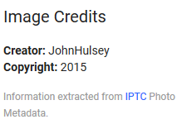
But there is a Silver Lining
Clean-up of legacy systems
Embracing the 4IR and rapid Digitisation (Elimination of Manual Processes)
Enhancing the control environment through hard coded systems controls
Opportunity for improving remote monitoring systems
Increased use Digital Forensics including remote Forensic tools
Improved corporate visibility though auditability of “Teams” and other collaboration platforms
Opportunity to reinforce employee trust and loyalty
The current crisis should be used by organisations to critically evaluate their ways of working and legacy systems.

Slide 14
THANK
YOU

