Slide 1
Practical Fraud Risk Management
Nicholas Harris

Slide 2
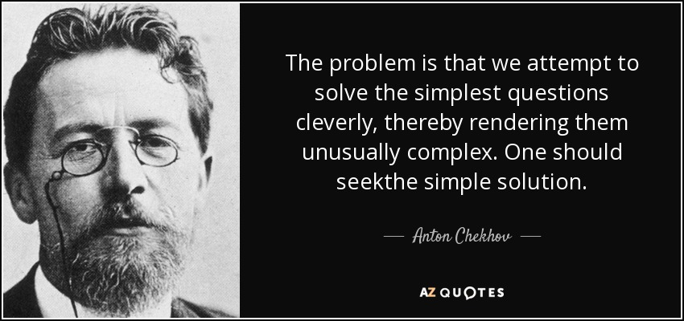
Agenda
Cultivating and establishing organisational Fraud Risk “Literacy”
“Murder” She Wrote – Unpacking the Fraud Risk Triangle
“SA’s got Talent” – The Fraud “X-Factor”
The Fraud Big Five including the Rats and Mice
Establish a Tool Box – Fraud Risk and Control Mechanisms

Slide 3
Group Rules
Please ask questions
Please ask questions
Please ask questions

Slide 4
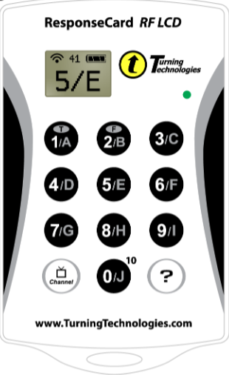
Technology – Polling
Green Flash Indicates Answer has been Received
Select corresponding Selection
Does not operate your TV or DVD Player
Displays option selected
Do not press Channel

Slide 5
Which invention did a South African not invent?
Kreeply Krawly
Pratley's Putty
The “CAT” Scan
Tin Foil
Q20
27 of 28
30

Slide 6
Please Select which Organisation Type you are from.
Big “4”
Medium to Small Firm
Private Consultants
Government
In-house Corporate
Other
35 of 36
30

Slide 7
What Forensic Specialisation are you mainly involved in?
Investigations
Forensic Technology
Fraud Risk Management
Fraud Detection
Other
37 of 38
21

Slide 8
Fraud Risk Literacy

Slide 9
Quick Poll: Do you believe you have Management Buy-in and support for fraud prevention activities (Exclude Investigations)
Yes
No
It Depends – Buy-in is there but the budget is not.
33 of 38
23

Slide 10
Cultivating Fraud Risk Literacy
Often, the biggest challenge to establishing an effective fraud risk management program is the organisational culture and obtaining top management buy-in.
Without these elements, any program is doomed to failure.
To do this we need to:
Understand and articulate the correct fraud risk exposure of the company
Establish the relative versus absolute fraud risk context
Develop and demonstrate the business case for fraud prevention
Develop a practical and pragmatic approach in dealing with fraud.

Slide 11
Cultivating Fraud Risk Literacy
Understand and articulating the true fraud risk exposure of the company
Unpacking the value at risk
Qualitatively
Culturally
Reputational – Customers and Suppliers
Operationally
Demonstrate the impact of the above on the organisation’s objectives
Establish the relative versus absolute fraud risk context
“Everyone Steals Stationary” – Relative Risk
“The collective impact of fraud resulted in the company not achieving their target” – Absolute Risk
The correct Fraud Risk context must be understood and communicated
Clarify Fraud Risk Appetite versus Zero Tolerance

Slide 12
Cultivating Fraud Risk Literacy
Develop and demonstrate the business case for fraud prevention
Fraud Multiplier
Cost of Rectification
Link to Brand Value
Organisational Culture
Regulatory Fines and Penalties
Develop a practical and pragmatic approach in dealing with fraud.
Need to offer a solution
Avoid the “Pie in the Sky”
Short to Long Term initiatives
Cost versus benefit taken into account

Slide 13
Fast Fingers First – Per the ACFE 2016 Report to the Nation, what is the current median losses in Sub-Saharan Africa, per fraud event?
$12 500
$143 000
$353 000
$76 000
35 of 38
26

Slide 14
Fastest Responders
Seconds | Participant | Seconds | Participant
16,661 | DAF97
16,677 | EC676
17,726 | DBE0D
20,258 | ECA55
23,199 | EC642

Slide 15
“Murder” She Wrote – Unpacking the Fraud Risk Triangle

Slide 16
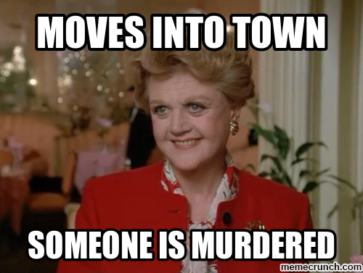
Unluckiest Women Alive?
Sometimes, as a fraud professional, I think we feel the same. I have heard all too often, before you came here, there was no fraud in my company.

Slide 17
Unpacking the Fraud Triangle
The fraud triangle, still relevant today, 43 years later.
Trusted persons become trust violators when they conceive of themselves as having a financial problem which is non-shareable, are aware this problem can be secretly resolved by violation of the position of financial trust, and are able to apply to their own conduct in that situation verbalizations which enable them to adjust their conceptions of themselves as trusted persons with their conceptions of themselves as users of the entrusted funds or property.¹
¹Donald R. Cressey, Other People's Money (Montclair: Patterson Smith, 1973) p. 30.

Slide 18
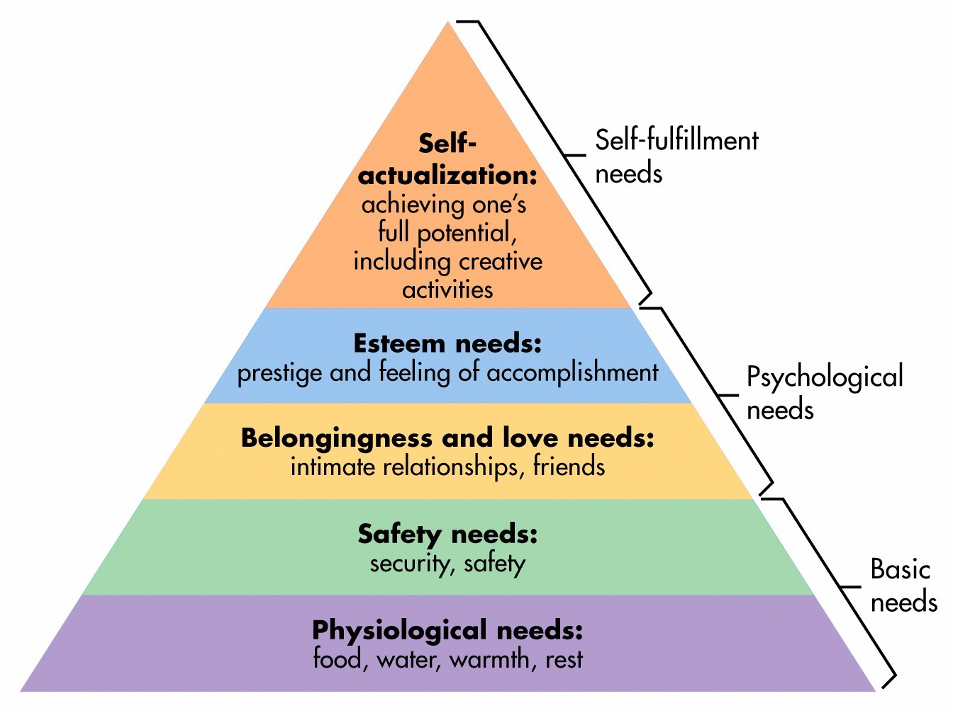
Unpacking the Fraud Triangle
Motivation
Understand Employee Motivations to commit fraud within your environment
Employee Support Programs can help
Proactive Screening (Credit Checks)
Incentive Schemes
Rationalisation
Ethics Management
Identify events that trigger rationalisation
Retrenchments
No Bonus / Increases
Unethical Management Practices
High Pressure Performance Environments

Slide 19
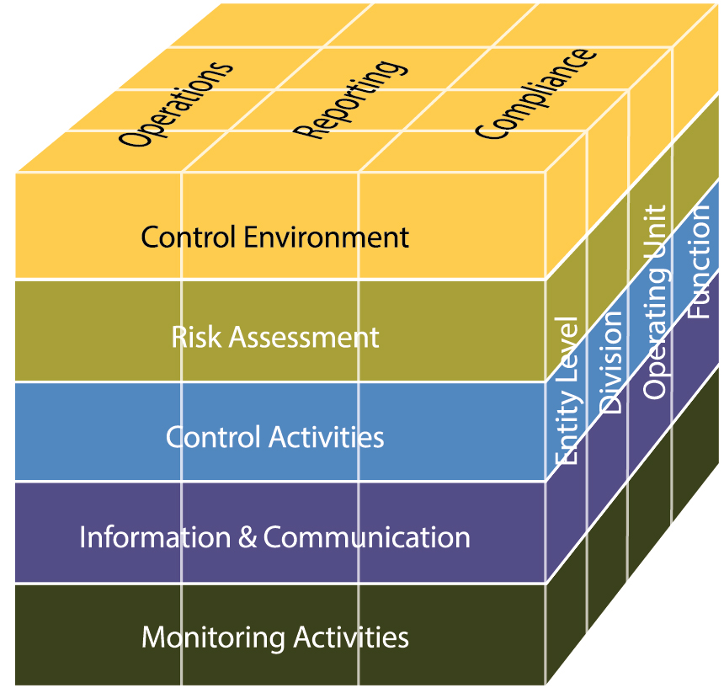
Unpacking the Fraud Triangle
Opportunity
Dependent on control environment
Understand the exposure areas
Control Environments are fluid and change management considered
IS Systems can complicate and enable fraud schemes
Focus on Primary Controls followed by Detective Controls
Do not underestimate the power of “Fear of Detection”

Slide 20
Group Poll – Does Your Organisation have any Formal Employee Support programs in Place
Yes – We do have a formal program/s in place
No – We do not have a formal program/s
36 of 38
30

Slide 21
Unpacking the Fraud Triangle
Do not under estimate the power of understanding what would motivate employee’s to commit fraud within your organisation and which areas they would mostly likely target due to weaker controls and less fear of detection. Often, these items take place in the context of a either an organisational culture that is conducive to rationalising fraud and or macro environment which supports it.
This understanding enables the fraud risk practioner to develop specific fraud preventions strategies to address particular risk areas while focusing already scarce resources.

Slide 22
Do you believe employee behaviour profiling will be acceptable in your organisation?
Yes
Maybe – Depending on internal safeguards
No

Slide 23
“SA’s got Talent” – The Fraud “X-Factor”

Slide 24
Poll: Which of the Following do you believe is the biggest Fraud X-Factor in your environment?
Information Systems and Computer Based Controls
Lone “Wolves”
Syndicated Activities

Slide 25
SA’s Got Talent
Avoid under estimating employees:
Younger Generation – Especially GEN C
Tech Savvy
More susceptible to syndicate pressure
Less consequence aware
Social Engineering
Further, the availability of information, has evolved to such a degree that detailed information is freely available online on how to bypass many security features enabled on laptops, banking platforms, common ERP platforms and even email spoofing

Slide 26
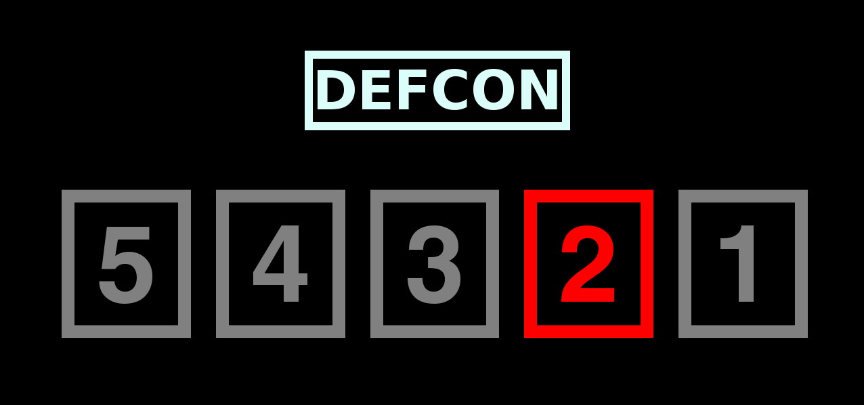
SA’s Got Talent
Consideration of the Following:
Complicated IT Environments
Strength of Change Management Programs especially during system upgrades / implementations on sensitive systems
Enforcement of SOD on critical systems
Logging / Auditing and Exception Reporting
Continuous Control Monitoring

Slide 27
Do you believe Line Management consults effectively with you in relation to significant organisational changes?
Yes
Yes, but normally at the last minute
No

Slide 28
Pre-employment Screening addresses which main aspect of a fraud risk strategy?
Fraud Prevention
Fraud Detection
Fraud Response
32 of 38
27

Slide 29
The Fraud Big Five including the Rats and Mice

Slide 30
Which of the following areas, do you believe is more susceptible to Fraud, generally speaking?
Cash
Stock and Assets
Procurement
Debtors
Payroll
27 of 38
23

Slide 31
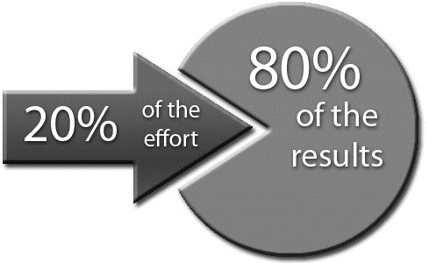
The Big - 5
Concentrate your scare resources on the main areas susceptible to fraud, avoid chasing the unicorn.
The most common areas susceptible to fraud include:
Cash
Stock and Assets
Procurement
Payroll
Debtors
Recognise and design detection controls in areas susceptible to collusion and management override:
Procurement
Disbursements
Stock / Asset Receipting
Scarce Resources

Slide 32
Don’t Forget the Rats and Mice
Don’t forget the rats and mice:
Expense and Travel Claims;
Asset Abuse
Overtime and Leave Abuse
Petty Cash
These have a significant cultural impact on the organisation. If left unchecked, may create an environment conducive to fraud.
The broken windows theory is a criminological theory of the norm-setting and signaling effect of urban disorder and vandalism on additional crime and anti-social behavior. The theory states that maintaining and monitoring urban environments to prevent small crimes such as vandalism, public drinking, and toll-jumping helps to create an atmosphere of order and lawfulness, thereby preventing more serious crimes from happening. *Wikipedia

Slide 33
Establish a Tool Box

Slide 34
A Glance Back at History
It’s said that accountants’ predecessors were the scribes of ancient Egypt, who kept the pharaohs’ books. They inventoried grain, gold and other assets. Unfortunately, some fell victim to temptation and stole from their leader, as did other employees of the king. The solution was to have two scribes independently record each transaction (the first internal control). As long as the scribes’ totals agreed exactly, there was no problem. But if the totals were materially different, both scribes would be put to death. That proved to be a great incentive for them to carefully check all the numbers and make sure the help wasn’t stealing. In fact, fraud prevention and detection became the royal accountants’ main duty
- American Accounting Journal 2000

Slide 35
Does your organisation have documented Fraud Risk Strategy in place, encompassing Fraud Prevention, Detection and Response?
True
False
30 of 38
25

Slide 36
Establishing a “Tool Box”
Recommended “Tool Sets”
Fraud Risk Strategy
Fraud Risk Universe
Fraud Communication and Training Plan
Fraud Risk Strategy Maturity Model
Stakeholder Reporting
Establishing a Fraud Risk Management Strategy that is unpacked at an activity layer, is one of the most effective fraud prevention Tools.
Core Elements of the Fraud Prevention Strategy
Unpacked at an activity layer with Accountability
Enablement of Visibility

Slide 37
Establishing a “Tool Box”
A Fraud Risk Universe:
Must be consistently maintained
Reflect the actual risk profile
Be careful of emotive ratings
Control effectiveness assessed via internal audit or amended based on actual incidents
Avoid negative controls stated as risks i.e. Lack of segregation of duties
Fraud Communication and Training Plan
Formalise Training Initiatives
Coordinate activities
Consistent across the year

Slide 38
Establishing a “Tool Box”
Establish Fraud Maturity Model
Balanced Score Card
View of Current State versus Future State
Enables Performance Management and Target Setting
Stakeholder Reporting
Reinforce the Business Case
Visibility to Stakeholders
Balanced between Proactive and Reactive
Avoid the Jargon and Clutter – Less is More

Slide 39
Other Considerations
Other Organisational Considerations
Change Management Programs
Proactive Products and Service Fraud Risk Consultation
Fraud Prevention by Design in Business Processes
Ethics Management Programs and Alignment
Information Security Alignment

Slide 40
Does your organisation have a formal ethics management program in place?
Yes
No

Slide 41
Capitalise on all Lines of Assurance
First Line
Third Line
Second Line
Management Attestations
Ethics Management
Risk Management
Compliance and Monitoring
Internal Audit
Forensics
External
Controls Self Assessments
Primary Anti-Fraud Controls
Front Line Employees

Slide 42
Employee Support Program’s addresses mainly, which aspect of the Fraud Triangle?
Opportunity
Rationalisation
Motivation
32 of 38
16

Slide 43
Fastest Responders
Seconds | Participant | Seconds | Participant
1,347 | EC97E
2,209 | EC62D
4,135 | DBD72
4,322 | EC94A
5,417 | DBD9A

Slide 44
Example – High Level Maturity Matrix
Governance
Board oversight
Authority
Objectivity
FRM Strategy
Policy Framework
Prevention
Detection
Response
Fraud risk assessments
Ethics & Culture
Whistle-blowing facilities
Fraud response plan
Fraud Control Framework
Continous Control Monitoring
Internal Report Mech
Investigation Manual
Fraud Prevention Training
Surprise Audits
Remedial Actions
Employee & supplier screening
Proactive Fraud data analysis
Post Fraud Control reviews
Underlying Controls – Weighting based on scoring

Slide 45
Closing Notes

Slide 46
Closing Notes
Adaptability, threat intelligence, practicality, return on investment and business focus are all factors that required consideration during the development of the organisations fraud risk strategy.
The measurement of success of an effective fraud risk strategy will be the ability to target and reduce fraud risk systematically inherent within the organisations environment while effectively detecting and responding to once-off fraud events due to collusion or skilled and motivated fraudsters.
An organisation can never reduce their risk of fraud to zero, but should ensure that should fraud ever occur, that the business can effectively continue to operate with a minimal impact on the achievement of its objectives, staff morale, and reputation.

Slide 47
THANK YOU

