Slide 1


STRENGTHENING FRAUD PREVENTION AND DETECTION STRATEGIES TO PROMOTE PUBLIC SECTOR ACCOUNTABILITY
Auditing, accountability and #cultureshift2030
ICFP Financial Crime Conference 2026 | 17 July 2026 | Gallagher Convention Centre
Keynote address by Ms Tsakani Maluleke CA(SA), RA
Auditor-General of South Africa
Notes:
Opening. Thank the ICFP board, CEO Chris de Beer, programme director, speakers and delegates. I am delighted for the opportunity to address you today and hope that you had very fruitful discussions in your first day.
The AGSA message is that truth matters, but truth must lead to consequence and reform. Position AGSA as part of the accountability ecosystem: independent audit insight, influence and enforcement, working alongside investigators, prosecutors, oversight bodies, professional bodies and citizens.

Slide 3




Constitutional and legislative mandate
3
Constitutional and legislative mandate
3
Chapter 9 of the Constitution
Mandate and functions
Chapter 9 of the Constitution of the Republic of South Africa, 1996, establishes the Auditor-General of South Africa (AGSA)
The functions of the AGSA are described in section 188 of the Constitution and further regulated by the Public Audit Act 25 of 2004 (PAA)
Section 188
The AGSA must audit and report on the accounts, financial statements and financial management of all national and provincial state departments and administrations; all municipalities; and any other institution or accounting entity required by national or provincial legislation to be audited by the AGSA.
Accountability
The AGSA is accountable to the National Assembly in terms of section 181(5) of the Constitution and section 3(d) of the PAA, and has to report on its activities and performance of its functions in terms of section 10 of the PAA.
Audit evidence
Oversight action
Investigation
Consequence
Notes:
Connect AGSA’s work to the conference theme. Financial audits show whether the numbers can be trusted. Performance information audits show whether reported delivery can be relied upon. Compliance audits reveal whether procurement, payment, contract management and financial management rules were followed. For a financial crime audience, compliance findings are often forensic risk indicators: weak evidence, missing documents, conflicted suppliers, irregular payments and poor monitoring may point to deeper integrity concerns.

Slide 4
Constitutional mandate and the work we do
4
1 000+
The AGSA has a unique whole-of-government view. Across financial, performance and compliance audits, the office generates credible information for management, oversight, citizens and the broader accountability ecosystem.
audits across all spheres of government each year
Financial information
Performance information
Compliance with legislation
Are the financial statements reliable and free from material misstatement?
Is reported delivery reliable and useful for accountability?
Were public resources used lawfully and within the prescripts that protect fairness and value?
Together, these audits serve as an early-warning system: they reveal weak controls, poor procurement, missing evidence, financial loss indicators and risk to service delivery before matters become investigations or commissions.
Audit evidence
Oversight action
Investigation
Consequence
Reform
Notes:
Connect AGSA’s work to the conference theme. Financial audits show whether the numbers can be trusted. Performance information audits show whether reported delivery can be relied upon. Compliance audits reveal whether procurement, payment, contract management and financial management rules were followed. For a financial crime audience, compliance findings are often forensic risk indicators: weak evidence, missing documents, conflicted suppliers, irregular payments and poor monitoring may point to deeper integrity concerns.

Slide 5

Our mission to advocate for effective national and provincial government culture
Demonstrate commitment to improving lived realities of South Africans by delivering on legislated mandate and strategic objectives aligned to people’s needs, being financially sustainable, and avoiding harm to public and public sector institutions
Implement and maintain institutionalised controls to ensure leadership and officials behave ethically, comply with legislation and act in best interest of institution, avoiding conflicts of interest
PERFORMANCE
INSTITUTIONAL INTEGRITY
CULTURE
ACCOUNTABILITY
TRANSPARENCY
Be responsive to public, oversight and other stakeholders through reporting and providing answers on mandated responsibilities fulfilled, actions taken and decisions made; ensure swift consequences for transgressions and poor performance
Provide public, oversight, auditors and other stakeholders with timely, relevant and reliable information on institution’s finances, performance, use of resources and compliance with legislation
Notes:
The principal of PATI has been developed with the strategic intent to move a critical mass of our auditees towards cultures and outcomes that reflects performance, accountability, transparency and integrity.

Slide 6

Commissions of inquiry
Notes:
Transition to audit outcomes. Explain that the following slides do not attempt to present the full general reports. They select the messages most relevant to financial crime, forensic risk, commissions of inquiry and the role of the accountability ecosystem.

Slide 7
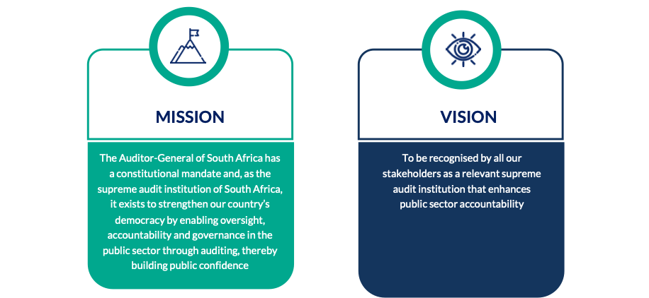
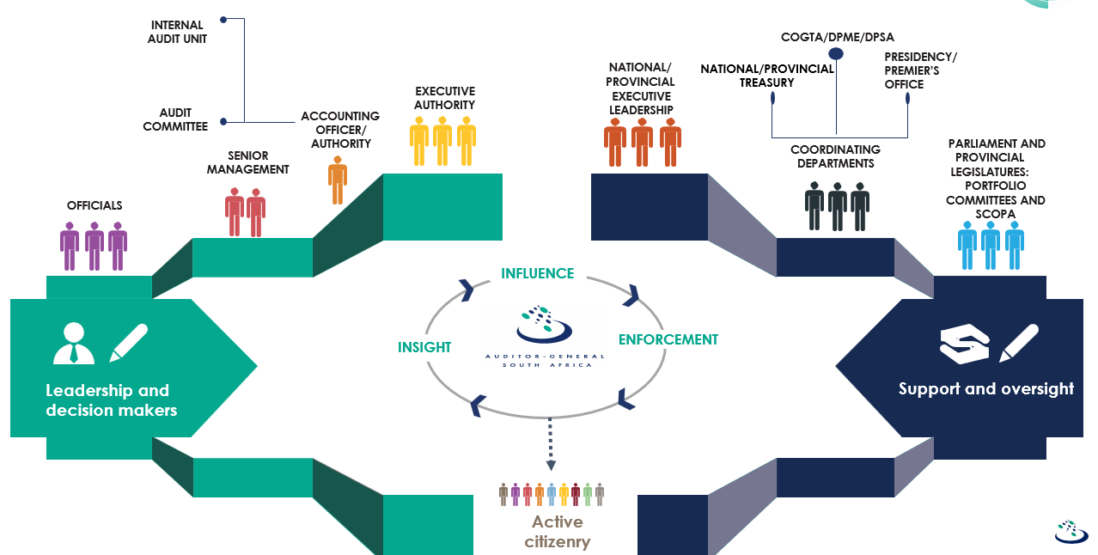
All have role to play in national government accountability ecosystem
Notes:
The ICFP audience sits within this ecosystem: forensic practitioners, prosecutors, investigators, digital-forensics specialists, auditors, professional bodies and law-enforcement partners. The central message is mutual dependence. AGSA generates independent audit evidence and insight. Accounting officers and authorities must respond, investigate, recover losses and strengthen controls. Oversight bodies must insist on corrective action. Public bodies take over where criminality, fraud, corruption or specialist powers are indicated. Courts and tribunals bring legal finality through setting aside, recovery and prosecutions. Citizens, media and civil society sustain transparency and pressure.

Slide 8

From truth to consequence
8
Accountability challenge
  Public sector must move from discovering truth to achieving real consequences and meaningful reform.
Role of auditing
  Auditing uncovers credible evidence about resource management but needs corrective follow-up action.
Continuous accountability process
  Accountability is ongoing, ensuring investigations lead to governance improvements and citizen benefits.
Collaborative ecosystem
  The AGSA works with investigators, prosecutors, oversight bodies, and civil society for effective outcomes.
Audit evidence
Oversight action
Investigation
Consequence
Notes:
Connect AGSA’s work to the conference theme. Financial audits show whether the numbers can be trusted. Performance information audits show whether reported delivery can be relied upon. Compliance audits reveal whether procurement, payment, contract management and financial management rules were followed. For a financial crime audience, compliance findings are often forensic risk indicators: weak evidence, missing documents, conflicted suppliers, irregular payments and poor monitoring may point to deeper integrity concerns.

Slide 9
Truth must move into action
9
Commissions can uncover truth and restore transparency. The governance test is whether that truth leads to consequence, recovery and systemic reform.
TRUTH
CONSEQUENCE
REFORM
Truth
Consequence
Reform
Establish facts, patterns and hidden conduct that were not addressed through ordinary controls.
Recover losses, discipline officials, refer matters, prosecute where appropriate and pursue contract remedies.
Strengthen controls, clarify accountabilities, build capability and prevent recurrence.
Supporting accountability with audit insights
  The AGSA’s audits provide evidence and identify weaknesses to ensure findings lead to corrective action.
When the accountability ecosystem works early and consistently, commissions become less necessary because public accountability happens in the ordinary course of governance.
Notes:
Deliver this with a constructive tone. Commissions are important accountability tools, but they often arise after warning signs were ignored, institutions were weakened and public trust was damaged. Truth without consequence risks becoming an expensive report. Consequence without reform risks isolated punishment without changing the system. AGSA’s position is pro-accountability: audit insight should be used earlier, and commission outcomes must flow into recovery, discipline, prosecution and institutional reform.

Slide 10
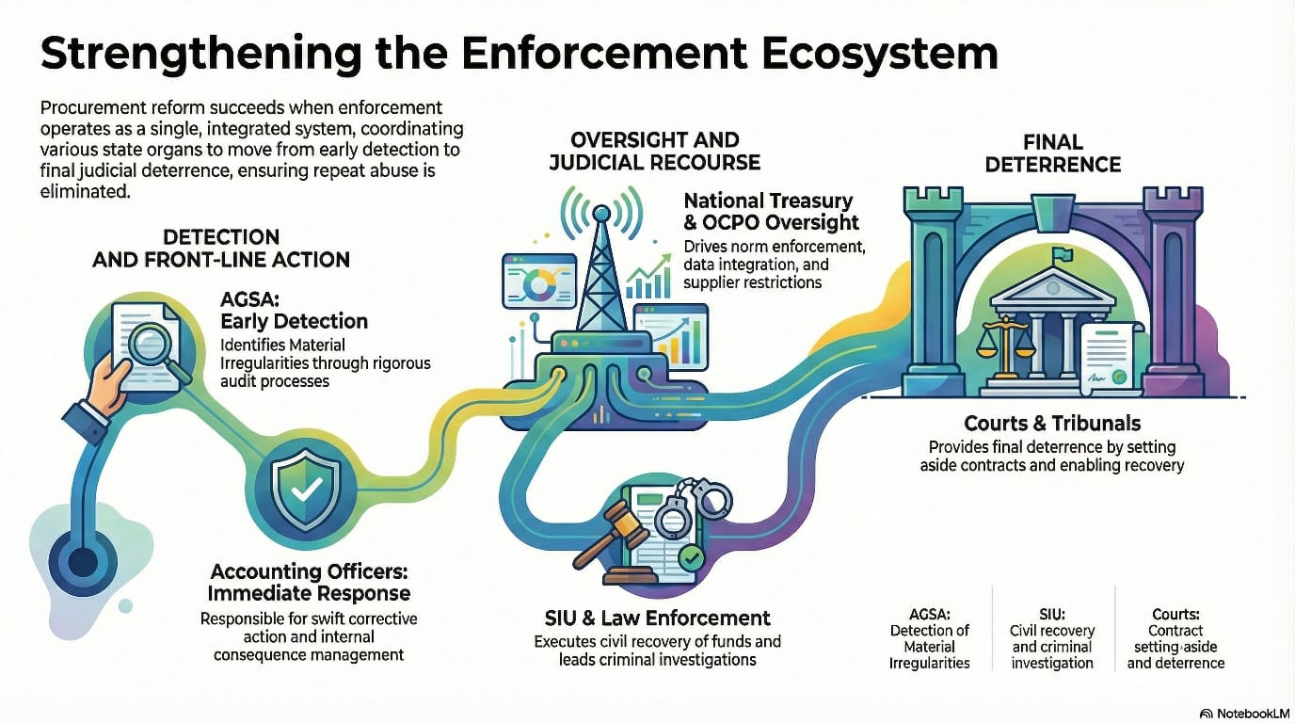
All have a role to play
10
Audit and insight role
  The AGSA delivers independent audit evidence and insights essential for accountability within the ecosystem.
Oversight and action
  Oversight bodies like Parliament demand action, monitor implementation, and uphold accountability standards.
Law enforcement and legal finality
  Public bodies and courts play critical roles in enforcement, recovery, and providing legal finality.
Transparency and public pressure
  Professional bodies, media, and civil society sustain transparency and maintain public accountability pressure.
Audit evidence
Oversight action
Investigation
Consequence
Notes:
Connect AGSA’s work to the conference theme. Financial audits show whether the numbers can be trusted. Performance information audits show whether reported delivery can be relied upon. Compliance audits reveal whether procurement, payment, contract management and financial management rules were followed. For a financial crime audience, compliance findings are often forensic risk indicators: weak evidence, missing documents, conflicted suppliers, irregular payments and poor monitoring may point to deeper integrity concerns.

Slide 11
Audit outcomes
What the latest PFMA and MFMA messages tell us
Notes:
Transition to audit outcomes. Explain that the following slides do not attempt to present the full general reports. They select the messages most relevant to financial crime, forensic risk, commissions of inquiry and the role of the accountability ecosystem.

Slide 12
KEY AUDIT MESSAGES
12
PFMA outcomes: the centre must model accountability
151 / 417
222
R42,58bn
95%
auditees achieved clean audits
with procurement and contract management non-compliance
irregular expenditure (IE) in 2024-25
IE linked to procurement and contract management
PFMA auditees must model the basics: credible records, lawful procurement, contract discipline, verified delivery and timely consequence management.
Procurement and contract management weaknesses remain a key leakage point.
Audit outcomes become meaningful when they change behaviour and protect public value.
The public value question is whether money was spent legally, economically and for intended outcomes.
Sources: AGSA PFMA 2024-25 General Report; AGSA presentation material.
Notes:
Use the numbers as anchors, not as a scorecard only. The key message for PFMA is that high-impact departments, entities and centre-of-government institutions must model accountability. Clean audits are important, but they must translate into reliable service delivery, strong procurement, proper contract management and credible reporting. The R42.58 billion in irregular expenditure, 95% linked to procurement and contract management, reinforces that these are not technical findings. They directly affect whether the state gets the right supplier, at the right price, with delivery at the right time and quality.

Slide 13
EXTENT AND INHERENT RISK
13
PFMA compliance findings: procurement remains the high-risk zone
Non-compliance with procurement and contract management legislation: 222 auditees.
222
210
74
77
procurement / contract non-compliance
uncompetitive and unfair procurement processes
material uncompetitive / unfair findings
inadequate contract management findings
RISK SIGNAL
Weak controls allow manipulation of specifications, evaluation, deviations, extensions, price and supplier performance. This creates conditions for financial loss, irregular expenditure, unfairness, service failure and fraud indicators.
Examples: missing procurement documentation, repeated single-bidder awards, awards to conflicted/non-compliant suppliers, and contract extensions without proper approval.
Sources: AGSA PFMA 2024-25 presentation; AGSA PFMA 2023-24 General Report.
Notes:
Elevate the inherent risks. Procurement findings indicate that controls were not strong enough to protect fairness, transparency and value. Missing records are not merely administrative; absence of a procurement trail can indicate concealment, poor record management or an inability to prove fairness. Examples include bidders disqualified on criteria not in the tender, quotation processes bypassed, preference points incorrectly applied, contracts extended after expiry and deliverables paid for without evidence. Data analytics can identify duplicate suppliers, repeated awards to related entities, abnormal pricing, awards close to thresholds, split procurement, extensions beyond thresholds and payments after contract expiry.

Slide 14
KEY AUDIT MESSAGES
14
MFMA outcomes: governance failures are felt in communities
215
R145,21bn
R40,14bn
101 / 129
municipalities with material compliance findings
irregular expenditure since 2021-22
IE incurred in 2024-25
audited infrastructure projects with findings
In local government, weak controls translate quickly into delayed infrastructure, unreliable basic services, financial distress and community harm.
The compliance finding is the visible symptom; the lived experience is the underlying impact.
Financial viability pressure and delayed supplier payments increase delivery risk.
Poor-quality or delayed infrastructure turns weak controls into community harm.
Source: AGSA 2024-25 local government audit outcomes material.
Notes:
For MFMA, the strongest message is that governance failures are experienced by communities. Weak procurement is not abstract: it affects water tankers, road maintenance, waste management, housing projects and electricity infrastructure. Material compliance findings at 215 municipalities show that basic rules are not consistently applied. The R145.21 billion in irregular expenditure since 2021-22 is a measure of repeated non-compliance across the administration. The finding that 101 of 129 audited infrastructure projects had findings demonstrates how failures in planning, procurement and contract oversight become delayed services and additional costs.

Slide 15
EXTENT AND INHERENT RISK
15
MFMA compliance findings: repeated failures weaken delivery
Procurement and contract-management findings remain pervasive across municipalities.
214
155
187
128
municipalities with procurement / contract findings
material procurement / contract findings
uncompetitive and unfair procurement processes
contract management non-compliance
RISK TO RESIDENTS
Market prices are not tested; contractors are not monitored; poor-quality work and delays increase costs; transparency weakens and communities wait longer for services.
Examples: water tanker verification failures, housing projects without basic services, delayed infrastructure, deviations from competitive bidding and panel use without adequate competition.
Sources: AGSA MFMA 2023-24 consolidated audit outcomes; AGSA MFMA 2024-25 material.
Notes:
For local government, the risk is immediate and visible. Uncompetitive procurement can lead to higher prices. Weak contract management means contractors are paid despite late, poor-quality or incomplete delivery. Audit limitations mean councils and the public do not have a full view of what happened. Use examples relevant to the audience: where water tanker services are not properly verified, we cannot prove services were delivered; where housing is provided without basic services, expenditure does not translate into an improved lived experience; where disciplinary boards do not act, the same findings repeat. Compliance findings therefore point to weak controls, resource leakage and poor services.

Slide 16
FROM DETECTION TO DETERRENCE
16
Irregular expenditure accumulates when consequences are delayed
R42,58bn
R32bn+
R145,21bn
87%
PFMA irregular expenditure in 2024-25
PFMA irregular expenditure under assessment
MFMA irregular expenditure since 2021-22
MFMA IE driven by procurement and contract management
ACCUMULATION TELLS US
Assessments are delayed or disputed.
Responsible officials are not identified timeously.
Recovery, discipline and prevention are postponed.
The same control failures recur.
The objective is not to count IE better — it is to resolve it, recover losses and prevent recurrence.
Sources: AGSA PFMA 2024-25 presentation; AGSA MFMA 2024-25 material; AGSA IE position paper.
Notes:
This slide should carry the consequence-management message. Irregular expenditure is a signal that the rules designed to protect public money were not followed. Accumulation means the signal is not being resolved. If the assessment, determination or investigation is delayed, the institution cannot identify responsible officials, quantify recoveries or correct the root cause. Examples include prior-year IE not assessed, recurring procurement deviations, contract extensions approved after expiry, payments without proof of delivery and procurement records not available for audit. Data analytics connects the dots: orders, contracts, quotations, supplier relationships, invoices and payments can be matched to show which payments relate to irregular decisions and where new leakage may be occurring.

Slide 17
Material irregularities
Enhanced powers for impact and consequence
Notes:
Transition to material irregularities. Explain that the MI powers are not a substitute for management responsibility. They are intended to strengthen accountability when accounting officers and accounting authorities do not act sufficiently on material non-compliance, fraud, theft or fiduciary breaches.

Slide 18
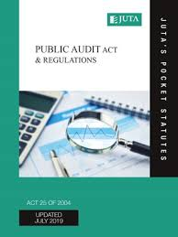
Constitutional and legislative mandate
18
Public Audit Act 25 of 2004
Section 20
AGSA must prepare an audit report containing an opinion / conclusion on:
Fair presentation of financial statements
Compliance with applicable legislation
Report of performance against predetermined objectives
Introduced concept of ‘material irregularity’ (MI)
Refer / remedial action
Certificate of debt
Public Audit Act 25 of 2004 – amended 1 April 2019 (expanded mandate)
Notes:
Clarify that MIs are not a parallel audit opinion. They are an enforcement mechanism designed to compel response where material harm, loss or public resource misuse is likely. The AG may refer an MI to a public body that is better placed to investigate, recover, discipline or pursue punitive action. This is particularly relevant where there are indicators of fraud, criminal conduct, political involvement, specialist matters or the public body has stronger investigative and remedial powers. The public body reports progress until completion.

Slide 19
DEFINITION • PROCESS • REFERRALS
19
Material irregularities: what the powers do
A material irregularity (MI) is non-compliance, fraud, theft or a breach of fiduciary duty that results in, or is likely to result in, material financial loss, misuse or loss of a material public resource, or substantial harm.
DEFINITION
Identify
Notify
Evaluate response
Recommend
Refer / remedial action
Certificate of debt
Purpose
Referral
Consequence
Compel response where material harm, loss or public resource misuse is present or likely.
Refer when a public body is better placed to investigate, recover, discipline or pursue punitive action.
Escalate from recommendations to remedial action and, where warranted, certificate of debt is issued.
Notes:
Clarify that MIs are not a parallel audit opinion. They are an enforcement mechanism designed to compel response where material harm, loss or public resource misuse is likely. The AG may refer an MI to a public body that is better placed to investigate, recover, discipline or pursue punitive action. This is particularly relevant where there are indicators of fraud, criminal conduct, political involvement, specialist matters or the public body has stronger investigative and remedial powers. The public body reports progress until completion.

Slide 20
NATIONAL AND PROVINCIAL MIS
20
PFMA material irregularities: targeting high-impact loss
31
63
R1,35bn
PFMA MIs at 17 auditees referred by 28 Oct 2025
procurement / contract-management MIs in PFMA analysis
estimated financial loss linked to those procurement / contract MIs
FOCUS
COLLABORATION
High-impact auditees, key value chains, MYAP themes, culture shift priorities and auditees classified as doing harm.
Referrals can support specialist investigations, recovery, supplier restriction, prosecutions and other remedies by public bodies such as the Special Investigating Unit, Hawks, National Treasury and the Public Protector.
The targeted MI approach is intended to shift behaviour, not only resolve isolated findings.
Analytics supports supplier intelligence, conflict indicators and abnormal payment patterns.
Notes:
For PFMA MIs, keep the message high-impact and professional. Examples include failure to deduct supplier penalties despite underperformance; fraudulent withdrawals after unauthorised changes to investor bank details; payments for goods or services not received; poor project management; delayed infrastructure and ineffective use of consultants. Explain the targeted MI approach: not every finding becomes an MI, but high-impact, transversal, leakage-related and recurring findings should be tracked and pursued. Collaboration with public bodies is essential where specialist investigation, prosecution, recovery or supplier action is needed.

Slide 21
LOCAL GOVERNMENT MIS
21
MFMA material irregularities: protecting communities
81
1
Community
MIs at 32 municipalities referred by 26 May 2026
Certificate of Debt
impact where water, electricity, infrastructure and payments fail
TYPICAL THEMES
Water and electricity losses; invalid indigents; revenue not collected.
Grants not used for intended purpose; payments not in line with contract.
Goods and services not received; lack of systems and records.
Delayed disciplinary processes; poor project management and service-delivery harm.
The MI process moves unresolved findings toward recovery, investigation, discipline and prevention, especially where communities are exposed to harm.
Notes:
For MFMA MIs, use concrete community-facing examples. Examples can include substantial payments with no equivalent benefits received, houses provided without basic services such as water and electricity, water tanker services paid or reported without reliable verification and monitoring, grants not used for intended purpose, goods and services not received and delayed disciplinary processes. These examples show why MIs matter: they connect audit evidence to public value. Emphasise collaboration: referrals to bodies such as the SIU, DPCI/Hawks, National Treasury and the Public Protector are made when their mandates and powers are better suited to investigation, recovery or punitive action.

Slide 22
WHY FINDINGS REPEAT
22
Root causes: recurring findings are symptoms of system weakness
01
Leadership tolerance
02
Basic controls not embedded
03
Procurement planning failures
Slow action on findings, weak ethical tone and limited accountability.
Reviews, reconciliations, evidence retention and approvals are inconsistent.
Needs, specifications, market testing and acceptance criteria are weak.
04
Contract management gaps
05
Consequence delays
06
Fragmented data
Performance is not monitored and deliverables are not verified before payment.
UIFW, fraud and misconduct are not investigated or dealt with timeously.
Systems do not connect procurement, contract, payment and performance information.
The shift required is from compliance as a year-end exercise to controls as daily management discipline.
Source: AGSA PFMA and MFMA general report insights
Notes:
This slide connects the PFMA and MFMA messages. Findings repeat because controls are not institutionalised. Leadership does not always treat audit findings as early warnings. Procurement planning is weak, specifications are vague or biased, contract monitoring is poor, and evidence is not retained. When consequence management is delayed, recurrence becomes rational: officials and suppliers see that transgressions are unlikely to result in recovery, discipline or prosecution. The solution must address culture and systems, not only individual transactions.

Slide 23
REMEDIES
23
Recommendations: move from findings to prevention, recovery and deterrence
1
2
3
4
Prevent
Detect
Act
Reform
Strong planning, fair specifications, market testing, independent evaluation and digital procurement trails.
Data analytics, exception reporting, supplier intelligence and continuous contract/payment monitoring.
Timeous IE/UIFW assessment, investigations, recovery, discipline and referrals to appropriate public bodies.
Fix policies, delegations, systems, roles and accountability lines so the same failure cannot recur.
Roleplayers should agree on who must do what, by when, with evidence of completion — and track whether the remedy actually prevents recurrence.
Notes:
Recommendations must not be generic. For AGSA’s message, every recommendation should lead to prevention, detection, action or reform. Prevention means stronger SCM planning, fair specifications, proper bid evaluation and clear acceptance criteria. Detection means analytics and continuous monitoring to identify anomalies before losses grow. Action means IE assessments, recoveries, disciplinary steps and referrals are not delayed. Reform means the institution changes its processes, delegations and systems so that the finding does not repeat. For commissions, the same logic applies: the response must turn truth into consequences and then into institutional reform.

Slide 24
CLOSING MESSAGE
24
CultureShift2030: the response after commissions
The desired legacy is not another report — it is a different public-sector culture.
Insight
know risks early
Influence
mobilise the ecosystem
Enforcement
ensure consequence
PATI: performance • accountability • transparency • institutional integrity
If all roleplayers fulfil their responsibilities, commissions become less necessary because accountability happens in the ordinary course of governance.
Notes:
Close with the positive CultureShift message. The response to commissions is not cynicism; it is a deliberate shift in culture. Insight means we identify risks and patterns early. Influence means we engage management, oversight bodies, professional bodies and public bodies so that findings do not sit idle. Enforcement means we use the enhanced powers when actions are not taken. The culture we want is PATI: performance, accountability, transparency and institutional integrity. If each roleplayer in the accountability ecosystem performs its role, the state becomes better governed, public resources are protected and ordinary South Africans experience better services.

Slide 25

Thank you
Notes:
Thank the ICFP, delegates and accountability ecosystem partners. End by returning to the central message: the role of commissions is strengthened when truth leads to consequence, reform and a CultureShift toward performance, accountability, transparency and institutional integrity.

