Slide 1

Effectiveness of Commissions of Enquiry in Addressing Corruption in South Africa and their influence on South Africa' image.
16 -17 July 2026: Xolisile Khanyile
Director: Langelihle Consultants

Slide 2
NATURE OF COMMISSIONS
Constitution: s 84(2)(f) President’s power to appoint commissions of enquiry.
Section 3(1) Commissions Act 8 of 1947 powers to summon and examine witnesses, administer oath/affirmation witnesses, compel production of documents, books and objects.
Failure to comply with a subpoena is a punishable offence.
Commissions Act: matter of public concern; Commissions remain advisory, not courts of law.
Secretary of the Commission v Jscob Gedleyihlekisa Zuma CCT 52/2021 Kampepe J
Compel testimony, defiance of the summons could result in contempt of court: 15 months

Slide 3
WHAT IS A COMMISSION OF ENQUIRY
Investigative body whose primary responsibility is to report to the President upon its findings. It is not entitled or empowered to take any action as a result of its findings.
Sparks v Sparks- Human J – an enquiry before a commission is not a proceeding in which there are interested parties who are entitled to a hearing and a verdict on the evidence.
Canada AG v Canada Commission of Enquiry on the Blood System- an enquiry is an investigation into an issue, event or series of events. Findings of a commissioner are simply findings of fact and statements of opinion reached by the commissioner at the end of the enquiry. Not bound by evidentiary and procedural rules of a courtroom. No legal consequences attached to determinations of a commissioner.

Slide 4
Purpose of the Presentation
Assess whether commissions meaningfully address corruption
Examine their value for law‑enforcement and institutional reform
Analyse their impact on South Africa’s domestic and global reputation
Highlight structural weaknesses: high budgets, unstructured data, limited prosecutorial value

Slide 5
Why use Commission
Respond to crises of legitimacy and major corruption scandal
Create an official, public record of wrongdoing
Provide recommendations for reform and accountability: whistle-blowers laws
Signal commitment to transparency domestically and internationally

Slide 6
Key Commissions Relevant to Corruption
Judicial Commission of Inquiry into Allegations of State Capture (Zondo)
Commission of Inquiry into Tax Administration and Governance at SARS (Nugent)
Commission of Inquiry into the PIC (Mpati)
Marikana Commission (Farlam) governance, policing, less directly corruption‑focused
Arms Deal / Seriti Commission procurement and defence acquisition

Slide 7
The State Capture Commission: 430 hearing days August 2018 to June 2022: Almost 1 billion
Exposed the scale and architecture of state capture
Many political figures implicated, some still in office
Revealed networks involving SOEs, Cabinet members, private actors
Whistle-blowers involved (Mcebisi Jonas and others) many suffered retaliation, job loss and threats
Produced a multi‑volume report with detailed recommendations
Reframed corruption as an organised, deliberate project

Slide 8
Zondo Key Recommendation
Institutional architecture: Anti-Corruption Strategy
Establish a permanent, independent anti‑corruption agency with investigative and prosecutorial powers (Standalone agency)
Strengthen NPA, Investigating Directorate, Hawks and SIU coordination
SOEs and procurement
Ensuring merit‑based appointments and protecting these institutions from political interference.
Professionalise boards and executives; merit‑based appointments

Slide 9
Zondo Key Recommendation
Tighten public procurement rules; centralised oversight for high‑risk contracts
Political and parliamentary accountability
Reform cadre deployment practices
Strengthen parliamentary oversight and ethics enforcement
Whistleblowers and protection
Enhance legal and physical protection; financial support mechanisms

Slide 10
Have we implemented the key recommendations
No chapter 9 permanent, independent anti‑corruption agency with investigative and prosecutorial powers.
IDAC not fully independent, part of NPA: reporting to Minister of Justice, no CEO/Accountable officer.
Whistleblowing: laws have been improved but there is no office responsible for whistleblowing.
No protection of whistleblowers, protection is for witnesses, no financial support.
NPA, Police strengthened as a result of the FATF Action Plan.
More than 200 cases referred, few convictions. Some progress SCCU & AFU
Major gabs in procurement policies: Some progress

Slide 11
Have we implemented the key recommendations
BO1: Collected and attended to as a result of the FATF Action Plan: Verification process still unclear as well as sanctions.
Political interference still persists: Madlanga revelations.
Intelligence and Law enforcement rebuilding: very fragile at the top, functioning better at the lower level: IDAC, SAPS and Crime Intelligence saga.
Parliamentary oversight: Enforcing Ethics: No progress, ministers implicated in State Capture and other criminal investigations are still in office.

Slide 12
PIC Commission (Mpati): sources & recommendations
Authority: Commission of Inquiry into Allegations of Impropriety at the Public Investment Corporation 54.5 million October 2018 to 12 March 2020
Triggered by whistleblowers emails: whistleblowers were victimised. The “James Nogu / Noko / Leihlohla” anonymous emails exposing PIC corruption.
Recommendations were:
Tighten investment governance and due‑diligence processes
Clear policies on conflicts of interest, related‑party transactions, and political influence
Stronger regulation of professional services: Professional enablers
Strengthen board oversight, audit and risk committees
Enhance transparency and reporting to depositors and the public
Refer specific matters for further investigation and possible prosecution

Slide 13
What has been implemented: Successful and impactful
A. Governance Reforms: Approved an interim organisational structure separating risk management, internal audit, and investment functions;
Strengthened oversight by the PIC Board and National Treasury (twin‑track process).
B. Ethics & Conduct: code of conduct for public representatives interacting with PIC.
Increased cooperation with Hawks and NPA on criminal matters.
C. Action on Improper Investments: Action taken against officials involved in the VBS matter.
Enforcement steps on Sekunjalo loan conditions.
Steinhoff. Finalised in court: Hawks and NPA working closely with PIC on referrals

Slide 14
Marikana Farlam: 34 pp killed: 153 m
Marikana (Farlam Commission):(Oct 2012–Jun 2015).
Focus on policing, use of force, and crowd management
Politicians were directly involved, and some were implicated in wrongdoing, though not criminally charged.
Governance failures and accountability, but limited direct corruption findings
The NPA charged 270 miners with murder, alleging they were collectively responsible for the deaths of their fellow miners.
This relied on the common purpose doctrine, historically used during apartheid to criminalise protestors.
After public backlash, the NPA withdrew all murder charges against the miners.

Slide 15
Marikana Farlam Criticism: Phiyega’ speech
The absence of prosecutions against police
The failure to hold Lonmin accountable
The state was criminalising the dead
Phiyega’s speech praising the police: 16 August 2012
“You did what you had to do. I want to thank you for the work you have done. Don’t be sorry about what happened.”
The Farlam Commission later criticised the tone and timing of her comments, noting that they appeared to endorse the operation before any investigation.

Slide 16
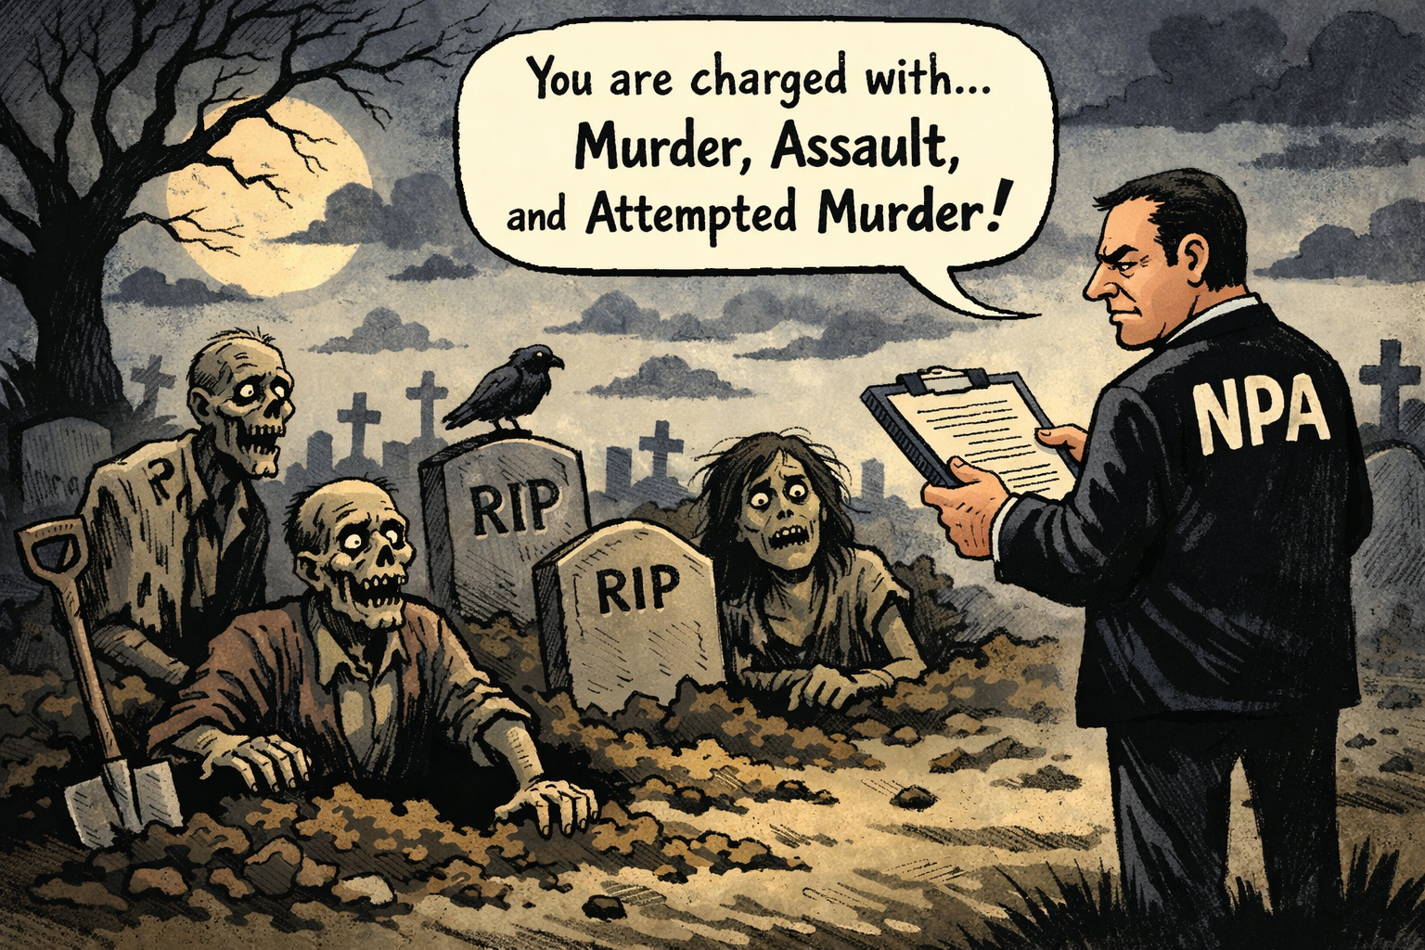
Marikana:

Slide 17
Arms Deal: Seriti) 2011 to 2016 (137.3 m)
Arms Deal (Seriti Commission):Investigate allegations of fraud, corruption, and impropriety in the Arms Deal.
Politicians were implicated in allegations.
Whisltleblowers involved, Terry Crowford Browne, Patricia de Lille, Andrew Feinstein (Former MP) and investigative journalists.
Assess whether the procurement was rational, whether the equipment was needed and used, and whether the promised economic benefits and job creation materialised.
  Found no widespread corruption; later heavily criticised
  2019 High Court judgment set aside findings for “manifest failure” to properly investigate
These commissions illustrate limits of commissions when evidence is constrained or approach is overly deferential.

Slide 18
Findings of Seriti J & Musi J
No evidence of corruption in the Arms Deal.
The procurement was “above board” and justified.
No wrongdoing by politicians, public servants, or contractors.
Allegations of bribery and kickbacks were dismissed as unfounded.

Slide 19
Appeal: The them Judge President Dunstan Mlambo
Committed a “manifest failure” in fulfilling its mandate:
Failed to inquire fully into the matters it was required to investigate.
Ignored thousands of pages of evidence from prior investigations.
Refused to admit highly incriminating documents even though it had the power to subpoena them.
Failed to test the evidence of key witnesses, including businessman Fana Hlongwane, who allegedly received R60 million from BAE Systems.
Showed bias by treating implicated individuals gently and allowing evasive testimony.

Slide 20
Cross‑cutting criticisms: cost, data, and law‑enforcement value
High budgets and long duration
State Capture Commission cost estimated at over R1 billion
Insufficient structured, prosecutable information
Narrative‑heavy reports; law‑enforcement must reconstruct dockets
Massive transcripts and document dumps, limited tagging and analytics
Conversion of testimony into admissible evidence is a challenge.

Slide 21
Not substitute for intelligence, investigation, prosecution and asset recovery
Use this budget to grow LEAS and provide them with skills matched to what the job requires.
As the FATF reports, 50 percent of the cases registered in SA are proceeds-generating crimes.
Supply LEA with AI tools that enable them to transform unstructured data into an organised form.
Continuously, the Presidency provides updates on how the recommendations are being implemented and on the policy shifts that follow.

Slide 22
Influence on South Africa’s image
Positive: Demonstrates openness, judicial independence, and willingness to confront corruption
Supports compliance with FATF, international partners, and investors
Negative: Public exposure of large‑scale corruption damages confidence
Greylisting and slow implementation signal capacity and political‑will gaps
Perception that commissions are “expensive truth‑telling” without consequences

Slide 23
Key lessons and reform directions
Design commissions with law‑enforcement in mind
Evidence standards, digital case‑management, structured data outputs
Link commissions to a permanent anti‑corruption architecture
Implement Zondo’s call for a specialised, independent agency
Statutory implementation mechanisms
Time‑bound action plans; regular public progress reports
Data and technology
Modern e‑discovery, analytics, and integrated databases for NPA, Hawks, SIU

Slide 24
Image of the country
Commissions have served as vital truth-seeking instruments within South Africa’s campaign against corruption
The Zondo, Nugent and Mpati inquiries yielded robust governance and anti-corruption proposals
Several factors limit how effective they can be:
  Steep costs, unstructured data, and weak follow-through into investigations, prosecutions and asset recovery and slow pace in policy changes.
The country’s standing improves when:
  Findings feed investigators, prosecutions, asset recovery and, ultimately, institutional reform

Slide 25
Risks to mitigate
Commissions are not structured to secure prosecutions or impose consequences.
Much of the information amounts to hearsay, requiring further investigation and collaboration.
Prosecution and investigation are processes that cannot be rushed.
Justice delayed is justice denied.
Greylisting resulted largely from state capture and the slow pace of concluding investigations, prosecutions and AR.

Slide 26
Way forward
The priority now is not to establish further commissions, but to implement the recommendations they have already delivered.
Good progress in Madlanga: LEAs are moving with investigations.
The powers afforded to politicians should be appropriately curtailed.
Zondo J
“If we do not implement these recommendations, state capture will happen again.”
“It is quite frustrating to have to preside over the swearing‑in of people who have been implicated in wrongdoing.”

Slide 27
Conclusion
A commission is only as valuable as the implementation of its recommendations, backed by strong political will and institutional follow-through. Where politicians themselves are implicated, such political will is unlikely to materialize

