Slide 1
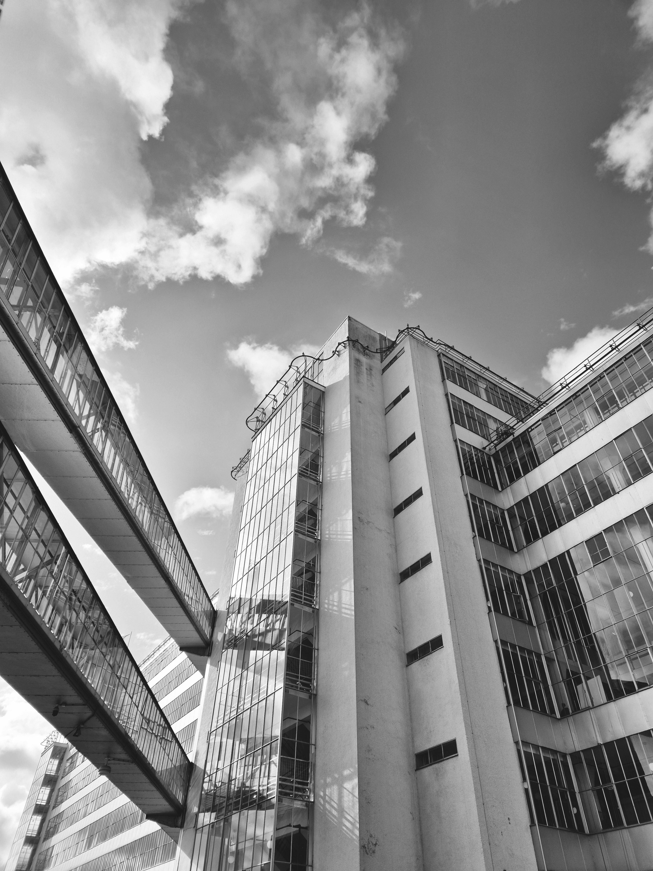


ANNE VENTER NWU BUSINESS SCHOOL
MASTERS TOPIC DISCUSSION
AN ANALYSIS OF THE ROLE OF COMMERCIAL BANKS IN THE DISRUPTION OF ONLINE SCAMS

Slide 2

Banks are central in the fight against financial crime.
Financial crime is complex & evolving.
WHY
THIS
TOPIC
Banks & its clients are targets of online scammers.
Technology is developing and available to everyone.

Slide 3

THREATS DO NOT FUNCTION IN ISOLATION
OBLIGATION TOWARDS ITSELF AND ITS CLIENTS?
CONTINUED
EXISTENTIAL THREAT TO BANKS = TRUST

Slide 4
LET’S TALK ABOUT...
APP FRAUD
WHAT MAKES APP FRAUD DIFFERENT?
SOPHISTICATED SOCIAL ENGINEERS?
VICTIM WILLINGLY AUTHORISES FRAUDULENT TRANSACTION
R1,2 BILLION LOSSES (SABRIC 2024)

Slide 5

THE PROBLEM
WHAT IS EXPECTED OF BANKS IN THIS BATTLE?
ELEMENT OF TRUST?
FINANCIAL CRIME, SPECIFICALLY ONLINE SCAMS, ARE TREATED AS ISOLATED EVENTS AND THE DOTS ARE NOT CONNECTED IN TIME.
COMPLIANCE - ONLY A “TICK BOX” EXERCISE?

Slide 6
THE QUESTION THIS STUDY ASKS
What role do South African banks currently play in the prevention, detection and disruption of online scams, and how can this role be expanded or strengthened?

Slide 7

CRIMINOLOGICAL APPROACH
Marcus Felson’s Routine Activity Theory
CONDITIONS
THAT MAKES
CRIME POSSIBLE
WHY

Slide 8


Marcus Felson’s Routine Activity
Theory
Motivated Offender
CRIME
Lack of
Capable Guardianship
Suitable
Target

Slide 9

ADDRESSED IN 2 ARTICLES
SYSTEMIC ROLE, LEGAL OBLIGATIONS AND RISK GOVERNANCE EXPECTATIONS
ANALYSIS OF APP FRAUD: TYPOLOGIES, MODUS OPERANDI, FUTURE STRATEGIES

Slide 10


ARTICLE 1:
BANKS
  Defining a bank.
  Traditional banking vs alternative payment systems.
  Banks are not simply intermediaries.
  ESSENCE OF A BANK

Slide 11
ARTICLE 1:
BANKS
  Building higher walls around financial institutions.
  Current legal obligtaions... none!
  UK’s Reimbursement Scheme.
  Risk Governance Structures.

Slide 12
ARTICLE 2:
APP FRAUD
  Banks are facing higher pressure to address APP Fraud.
  Industry collaboration efforts.
  Modus Operandi.

Slide 13
ARTICLE 2:
APP FRAUD
  Current initiatives.
  HOLISTIC APPROACH.
  Recommendations on how this can be combatted.

Slide 14
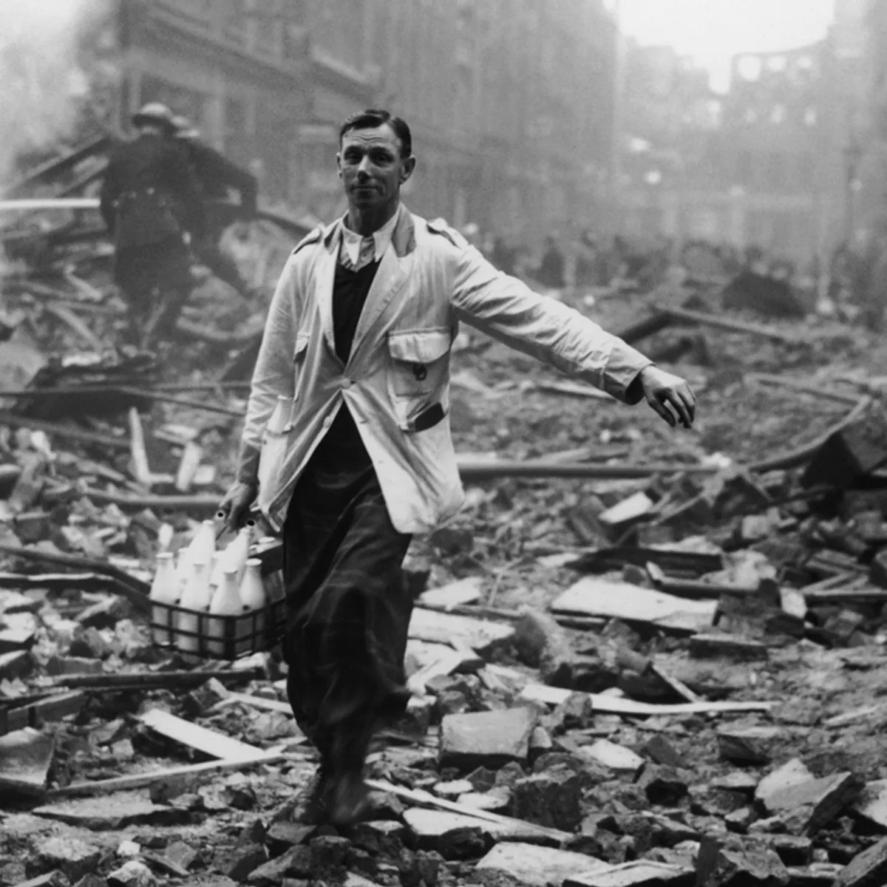

CONCLUSION

Slide 15

THANK YOU
QUESTIONS?

