Slide 1


Beneficial Ownership Structures
Dr Paul Gilmour

Slide 2

Dr Paul Gilmour
Thank you
paul.gilmour@port.ac.uk

Slide 3
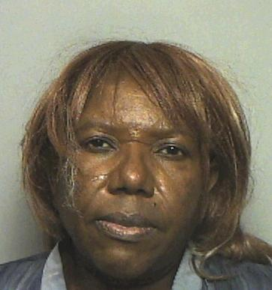
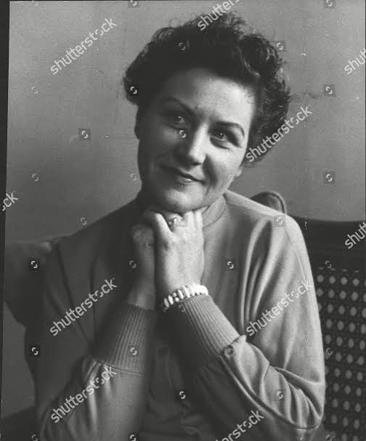
Pepe Chisenga
Elizabeth Campbell (1921-2018)

Slide 4

Beneficial ownership
FATF defines ‘beneficial owner’ as
“… the natural person(s) who ultimately owns or controls a customer and/or the natural person on whose behalf a transaction is being conducted. It also includes those persons who exercise ultimate effective control over a legal person or arrangement”
(FATF, 2014, p. 8).
Notes:
EU’s 4th Anti-Money Laundering Directive (Council Directive 2015/849EU).
Listed tax offences as predicate crimes to money laundering.
Obliged EU Member States introduce registers of beneficial owners.

Slide 5
A concept historically derived from trust law
Beneficial ownership:
recognises the fundamental separation of the legal and rightful owner of assets or other property.
determines the equitable interest in property through the principle of equity, a remedial measure that seeks to overcome injustice caused by the strict application of common law rules.

Slide 6
OECD Model Tax Convention (on income and on capital) 1977
Provides tax advice for countries engaged in bilateral negotiations with the aim of preventing businesses paying tax again on the same source of earned income when trading across jurisdictions (a principle known as double taxation).
Emphasizes that the person who has the “right to use and enjoy” passive income (meaning dividends, interests, or royalties) is considered the beneficial owner.
Notes:
Intended to offer clarity to the notion of beneficial ownership and was done against the background of the Model Tax Convention’s aim of preventing double taxation, tax avoidance, and evasion.

Slide 7
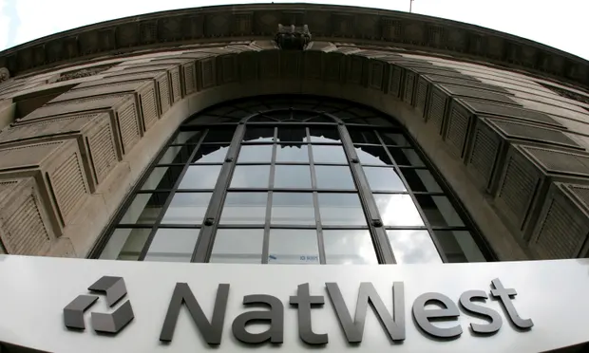
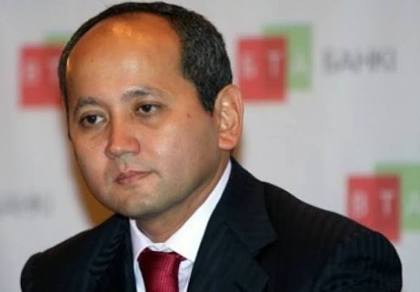
NatWest bank scandal (2021)
“NatWest faces £340m fine after admitting ‘money-laundering’ failings”.
Failure to monitor and supervise transactions.
£365m deposited into the account of a Bradford jeweller.
Mukhtar Ablyazov (2005-2009)
Concealed his beneficial ownership of BTA Bank
Implicated in $8 - $12 billion fraud case

Slide 8


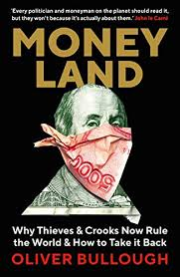
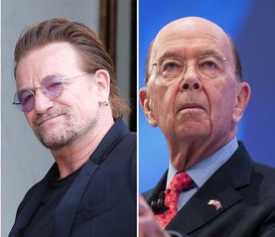
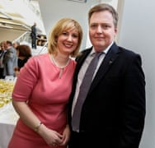
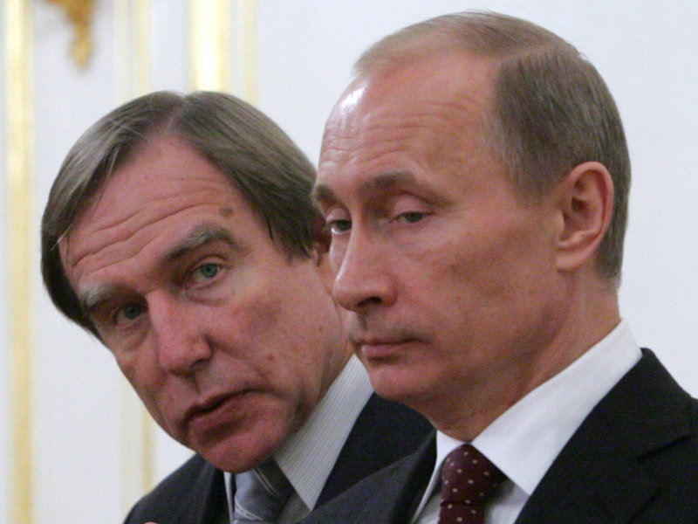
Secretive world of offshore banking
‘Panama Papers’ (2016) - Over 300,000 offshore clients within 11 million papers from Panama-based law firm, Mossack Fonseca.
‘Paradise Papers’ (2017) - Involving Bermudan law firm, Appleby.

Slide 9

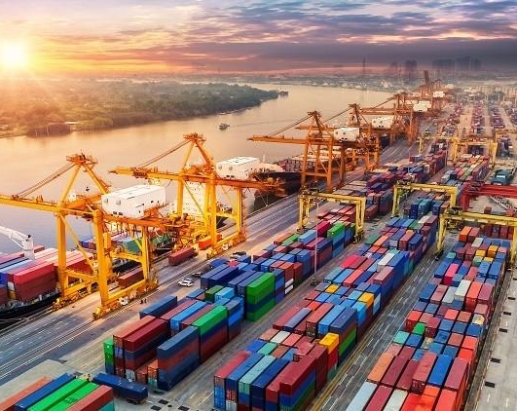
Globally dominate OFCs
Saint Kitts and Nevis; The Republic of Panama; The Bahamas;
The British Overseas Territories of the British Virgin Islands and Cayman Islands;
The British Crown dependencies of the Isle of Man, Jersey, and Guernsey
Switzerland; Hong Kong; Singapore; Delaware, USA.
Notes:
Switzerland dominates around 5% of the international financial market and manages over $3.1 trillion worth of assets originating from abroad (Tax Freeports Warehouses located within free-trade zones that lie within a country’s geographical border but are designated by that country’s government to be outside its normal customs regime.

Slide 10


‘Tax Haven’ vs ‘Secrecy Jurisdiction’
Little or no tax.
Tax law is modified to attract foreign investment.
Merely a sense of
a lower tax burden.
Laws purposely limit sharing of clients’ financial information.
Strict, often legally-enforced client-confidentiality rules.
Act to undermine overseas rule of law?
Tax
Haven
Secrecy Jurisdiction
OFC

Slide 11
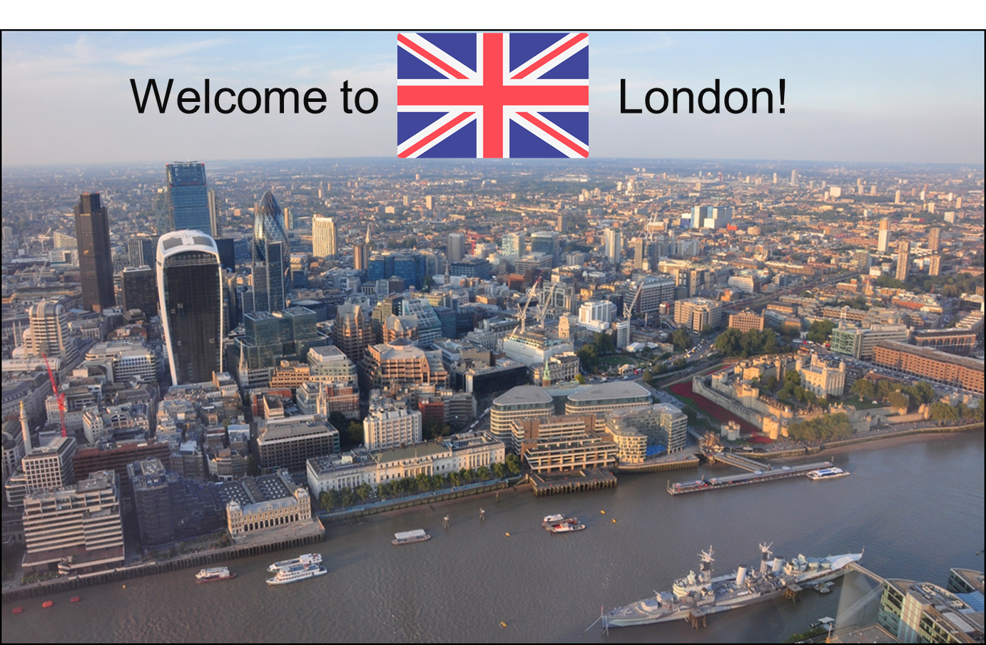
The Money Laundering Capital of the World
“over 90% of the companies owning 44,022 properties in London were registered in secrecy jurisdictions” (Transparency International UK, 2017).

Slide 12
FATF Recommendations 24 and 25
“Countries should ensure that there is adequate, accurate, and
up-to-date beneficial ownership and control information on
express trusts and similar legal arrangements”
“In the identity verification processes, appropriate steps should be taken to prove that a natural person, who has been identified as a beneficial owner, exists and is who they claim to be, e.g., by reviewing government-issued identity documents …”
Transparency Access Verification

Slide 13
EU 4th AML Directive (Council Directive 2015/849EU).
Listed tax offences as predicate crimes to money laundering.
Obliged EU Member States introduce registers of beneficial owners.
UK law via the Small Business, Enterprise and Employment Act 2015 mandated for UK-incorporated companies to be listed on a central register.
    Available to the public.
    PSC’s full name, date of birth, nationality, residential address, and the nature of their control over the company.

Slide 14


Registers of beneficial owners
‘Persons of Significant Control’ (PSC) register (2016).
    Available to the public at no cost.
‘Trusts Registration Service’ (2017).
    Only accessible to those with a ‘legitimate interest’.
The Register of Overseas Entities (2022).
    Contains information about who owns and controls
    foreign entities owning property in the UK.
Notes:
Initially, the EU 4ALMD was transposed into UK law via the Small Business, Enterprise and Employment Act 2015, which mandated for UK-incorporated companies to be listed on a central register.
Available to the public.
PSC’s full name, date of birth, nationality, residential address, and the nature of their control over the company.
‘Trusts Registration Service’ (2017).
Unavailable to the public - only accessible to UK policing authorities and the UK FIU (those with a ‘legitimate interest’).
The Register of Overseas Entities (2022).
Shall contain information about who owns and controls
foreign entities owning property in the UK.

Slide 15
Challenges to enhancing beneficial ownership transparency
Concealment of beneficial owners
Role of professional intermediaries

Slide 16
Challenges to enhancing beneficial ownership transparency
Complex corporate structures
Banking secrecy
Legal Professional Privilege

Slide 17
Challenges to implementing registers of beneficial owners
Concerns over data privacy
Intergovernmental cooperation
Ineffective legal framework

Slide 18

Registers of beneficial owners: a flawed system?
> 335,000 | Have no beneficial owner.
390 | Politician.
> 10,000 | Foreign company.
390 | Part of a circular ownership structure where they appear to control themselves.
9,000 | Control over 100 other companies.
2,160 | Born in 2016, or list date of birth as ‘9988’.
(Global Witness, 2018).

Slide 19
Rights to Privacy
WM and Sovim SA v. Luxembourg Business Registers, 2022
Unlawful for EU Member States to make information on beneficial owners within registers accessible “in all cases to any member of the general public”
Judges ruled … “serious interference with the fundamental rights to respect for private life and to the protection of personal data”

Slide 20
Economic Crime Acts
Economic Crime (Transparency and Enforcement) Act 2022
    New Register of Overseas Entities.
    Unexplained Wealth Orders.
    Sanctions.
Economic Crime and Corporate Transparency Act 2023
    Updates to Companies House.
    Identification and verification of
    Limited Partnerships and other corporates.
    Registration of overseas entities.

Slide 21

Investigating how accountants use information on beneficial ownership to manage money-laundering and terrorist-financing risks
Understanding of FATF Guidelines
Challenges
Regulatory and Compliance
Tools and Resources and Digital Infrastructure
Recommendations and Best Practice
Training Needs

Slide 22
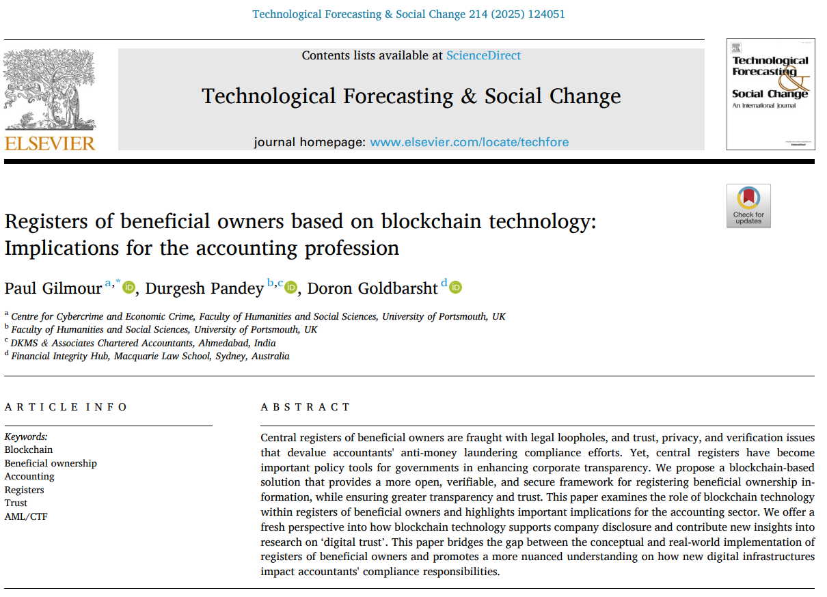

Slide 23
Dr Paul Gilmour
Senior Lecturer in Economic Crime, University of Portsmouth
Extraordinary Associate Professor, North-West University
paul.gilmour@port.ac.uk

